Slide 1

Hotel Aggregator Analysis PowerBI Visualization
Surathni Gunawardena

Slide 2
Table of Contents
01
02
03
04
Problem Statement
Project Objectives
Key Insights
Recommendations
Surathni Gunawardena

Slide 3
Problem Statement
This project aims to analyze a dataset of hotel aggregator listings using Power BI. The dataset comprises various attributes related to listings, hosts, reviews, and availability. The objective is to create comprehensive visualizations and insights that shed light on trends, patterns, and factors influencing the performance of listings.
Surathni Gunawardena

Slide 4
Project Objectives
1. Geographical Insights:
Visualize the distribution of listings on a map to identify popular neighborhoods.
2. Pricing and Availability Analysis:
Analyze pricing trends based on property types, room types, and accommodation capacity.
3. Host Performance:
Evaluate host characteristics, including super host status, response times, and verification methods.
4. Review Scores and Guest Satisfaction:
Examine review scores and their impact on overall listing performance.
5. Property Type and Room Analysis:
Analyze the distribution of property types and room types.
Surathni Gunawardena

Slide 5
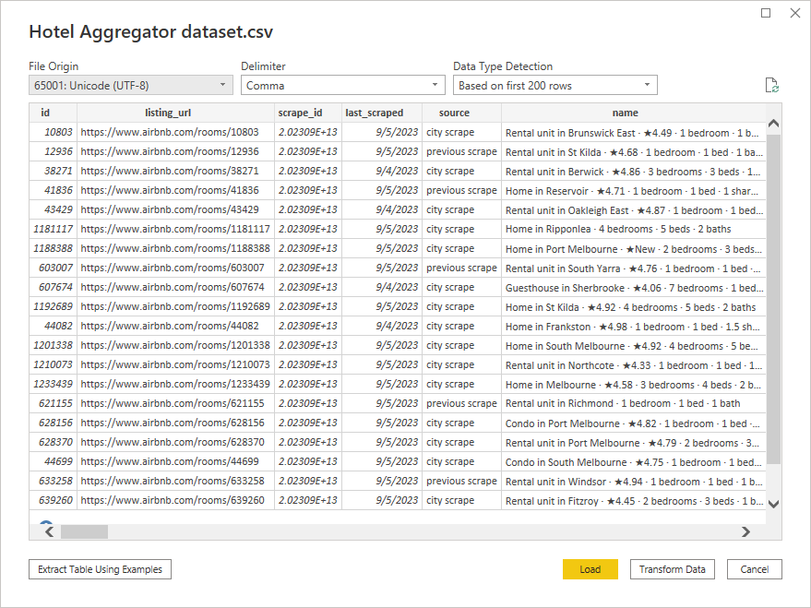
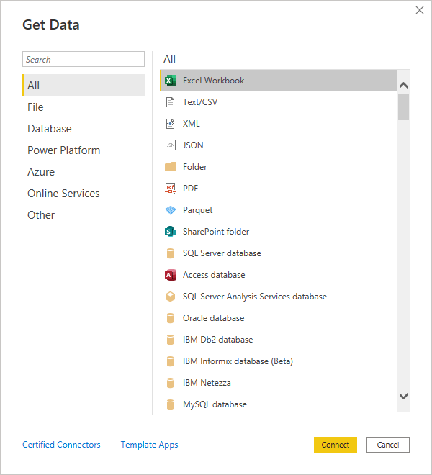
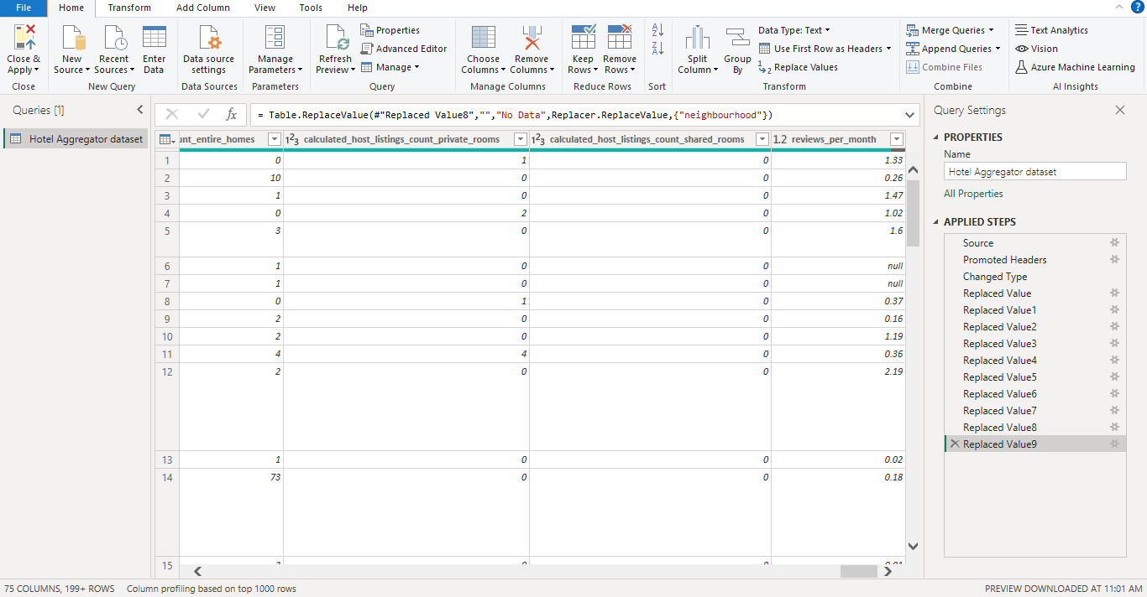
Surathni Gunawardena

Slide 6
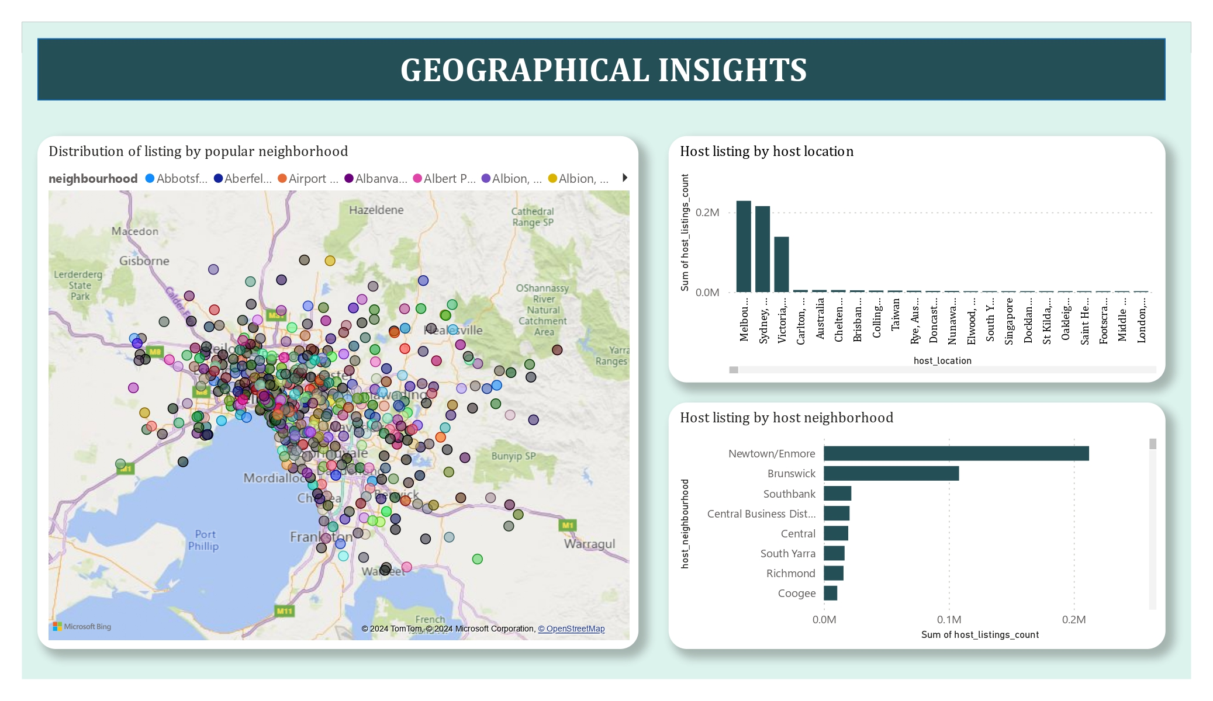
Surathni Gunawardena

Slide 7
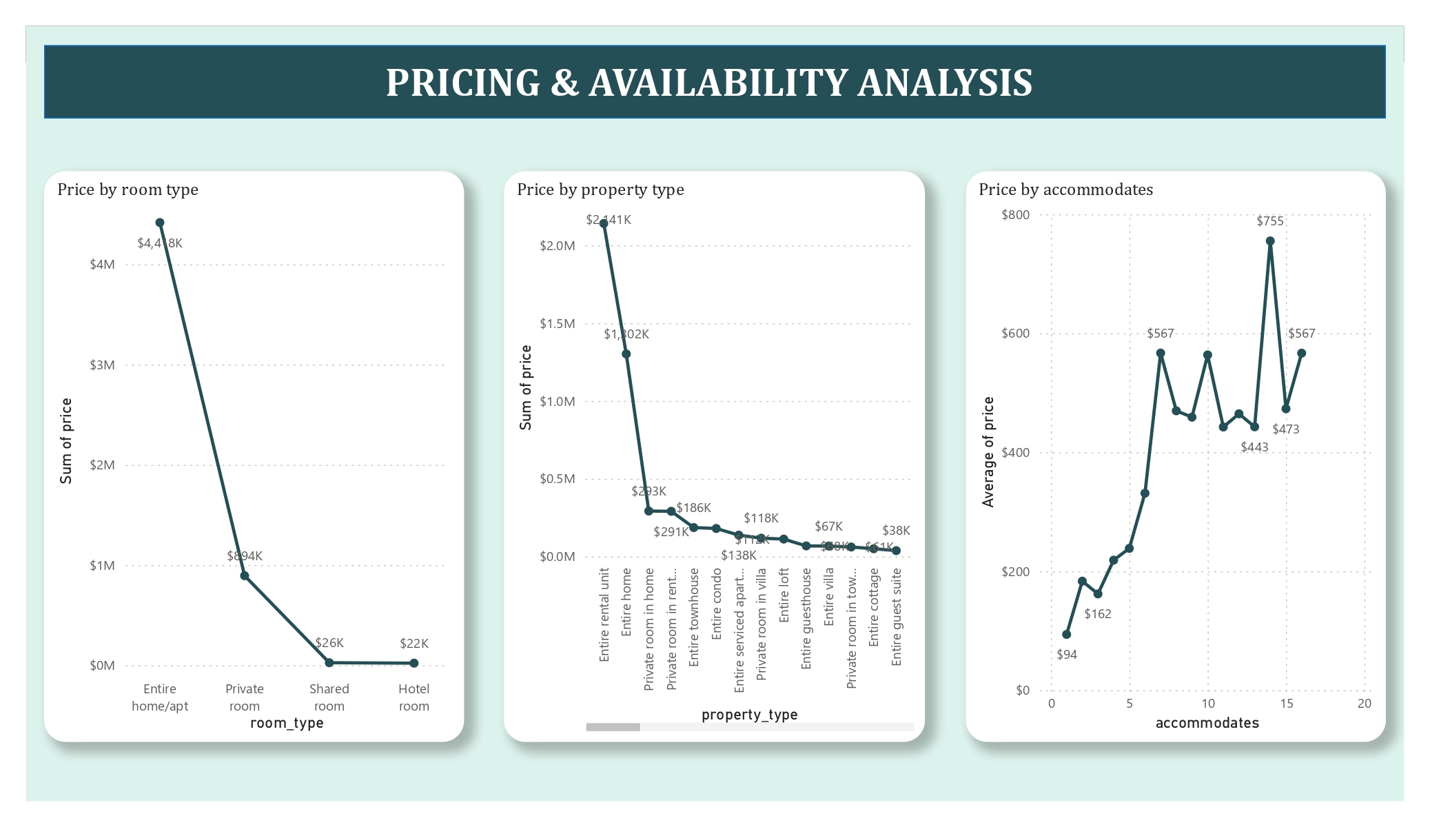
Surathni Gunawardena

Slide 8
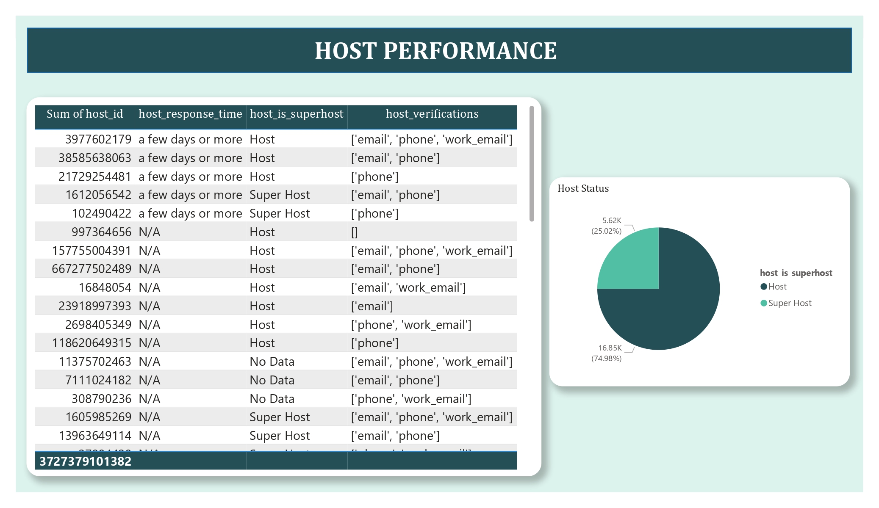
Surathni Gunawardena

Slide 9
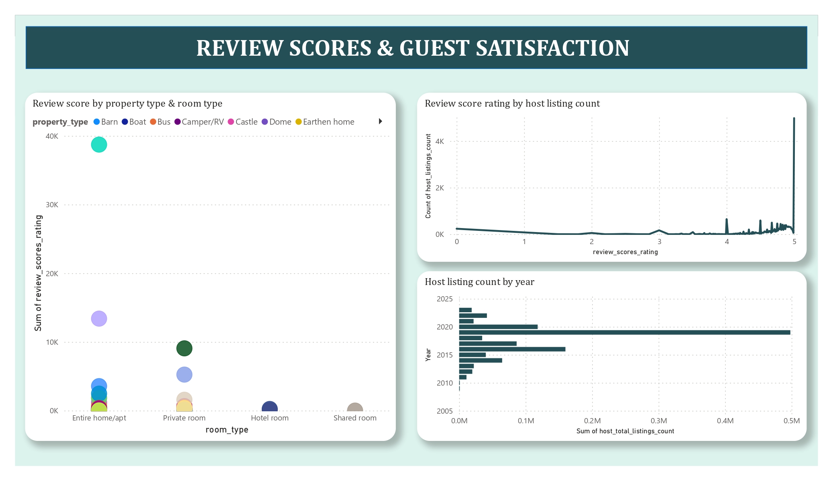
Surathni Gunawardena

Slide 10
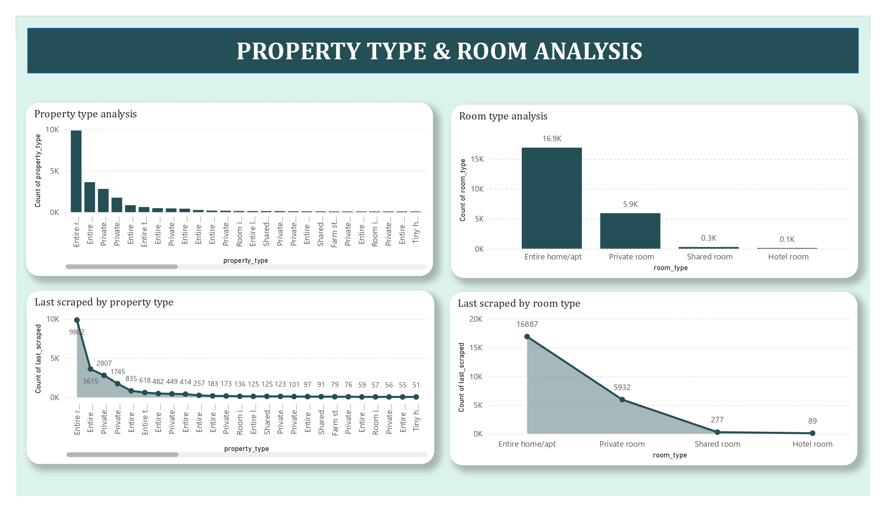

Slide 11
Key insights
Geographical insights: Provides insights into the distribution of listings in popular neighborhoods, host locations, and host neighborhoods. It shows where properties are concentrated, where hosts are based, and which areas are popular among hosts and guests.
Pricing & availability analysis: It showcases average prices for different property types, room types, and based on accommodates.
Host performance: Presents insights into host performance metrics such as host response time, host verification methods, and host status. By analyzing this data, one can understand the distribution of host response times, verification methods used by hosts, and the proportion of super hosts versus regular hosts.
Review scores & guest satisfaction: It displays the relationship between review scores and host listing counts, host total listings count by year, and review scores based on property and room types. This data helps in understanding guest satisfaction levels, trends in review scores over time, and the impact of property and room types on guest experiences.
Property type & room analysis: It presents the count of different property types and room types, showcasing the distribution of accommodation options.
Surathni Gunawardena

Slide 12
Recommendations
Host Performance Optimization:
Encourage hosts to maintain quick response times to enhance guest satisfaction.
Promote the use of multiple verification methods to build trust with guests.
Consider the benefits of achieving super host status for improved credibility.
Pricing and Availability Strategies:
Analyze pricing trends for different property and room types to set competitive rates.
Adjust pricing based on accommodates to maximize revenue and occupancy.
Monitor availability to capitalize on high-demand periods and adjust pricing accordingly.
Surathni Gunawardena

Slide 13
Recommendations
Guest Satisfaction Enhancement:
Focus on improving review scores by providing exceptional service and amenities.
Track guest satisfaction levels over time to identify areas for improvement.
Tailor property and room offerings to meet guest preferences and enhance satisfaction.
Property and Room Type Management:
Understand the popularity of different property and room types to optimize inventory.
Diversify offerings based on demand for specific accommodation options.
Utilize insights to enhance marketing strategies and target relevant customer segments.
Surathni Gunawardena

Slide 14
Thank you!
Surathni Gunawardena

